Slide 1
Do not edit
Immersion Session

Slide 2
The work we have done so far
Do not edit
Ethnographic Research
We focus on surfacing latent unmet needs that are critical in shaping new products and services
22 Consumers
5 SMEs
40+ Hours Interviews
Industry Experts
Network of subject matter experts were surveyed and interviewed to provide insight
Co-founder of Expense Check
Former Wealthfront Executive
Dobot Executive
Former iSelect and Comparethemarket Executive

Slide 3

Do not edit
Rentlord
Digital property management suite

Slide 4



Frictions
Do not edit
Voiceover
Administration burden across Tenants: Tenants within a share house can find it challenging to track, split, pay and reconcile household expenses such as bills and rent.
Creation of conflict and disputes: The responsibility of managing people and money is often left with one person to coordinate; and can easily lead to conflict and divide between tenants if misalignment arises
Tenants suffer from inefficiencies in coordinating service providers
Organising to have maintenance issues fixed can be timely and frustrating for tenants and service providers who have to go through a rental property manager.
Landlords question the value & cost of Property Managers
Landlords outsource property management for convenience and assurance of quality of care; however they are often left questioning whether their interests are being put first.
“I had a problem with our dryer but I had to wait two weeks before I was able to get confirmation from the real estate agent to get it replaced.”
“I don’t trust the real estate agent. They seem to be getting the tradies who give them the best deal but not necessarily what’s best for me”
Ray
Rhun

Slide 5

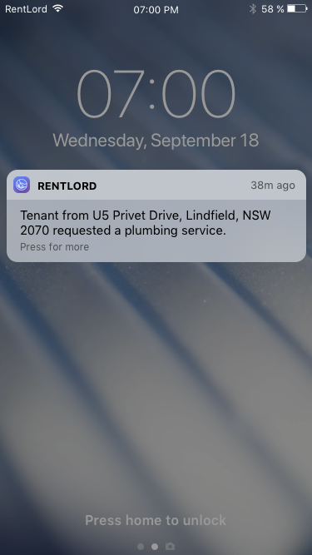
Do not edit
Rentlord
Digital property management suite
Rentlord is a platform that offers Landlords a suite of property management services to reduce or remove their reliance on traditional Property Managers.

Slide 6



Do not edit
Smart Payments & Administration
Streamlined Request
Management
Intelligent Listing
RentLord provides Landlords with a centralised location to manage and conduct their end to end property financial management and administration
RentLord optimises the management of requests by assigning tasks and actions to the appropriate stakeholder, generating faster results and a positive experience
Rentlord facilitates the listing process by providing Landlords with listing expertise and support. Property listings are automatically published to multiple digital channels, maximising market exposure

Slide 7
Market Opportunity
Suggested
Voiceover
Property agents license the platform to offer to their multiple tenants
Lead generation from utility providers offering services to the tenants/property managers
Charge the landlord a percentage of each payment
Subscription model - Tenants subscribe to the service on a monthly/yearly basis
Potential Revenue Models
Market Size
Rental properties managed by landlords
Commissions
Commission from the jobs performed by 3rd party maintenance providers and real estate tech providers plugging into the platform
Subscription
Landlords subscribe to the service on a monthly/yearly basis
License model
Property managers license the platform to offer to their landlords as a digital value added service
1
2.3 Million
Total Market
Australian homes with a landlord
2
1.4 Million
Addressable Market - Landlords who self manage properties
Leader (60%)
828,000
Challenger (30%)
414,000
3
Share of Market - Duopoly - 60%, 30%, rest (equivalent to REA/Domain, ticketing sector etc)

Slide 8















Competitive landscape
Do not edit
Voiceover
The property listing market is dominated by REA and Domain while individual startups are targeting property buying, property managers and verticals within the rental value chain
:Different and Instarent are relatively new entrants and they have recently been gaining significant traction in Australia
Opportunity for property management is still significant in Australia (i.e. over $5.5Bn)
SET UP
MANAGEMENT
Listing property and accepting applications
Vetting tenants and finalizing tenancy
Managing admin and payments
Handling property requests and inspections
General
Targeting Landlords

Slide 9
How it works
Suggested
Voiceover
Shown here are the high-level journeys for the set up, ongoing payments and maintenance of a property on behalf of a landlord.
For set up, we provide a low-touch experience, using existing property listing platforms to attract potential tenants and a gig-economy workforce to perform house inspections on request. After submitting their application, Rentlord reviews and makes a recommendation on the most suitable tenant.
The ongoing use of Rentlord as a platform (including smart payments and administration, request management and listing support) commands a subscription fee from the landlord, which can be either a monthly flat fee, or a % based on the rent amount
For maintenance requests, we connect landlords with a curated selection of relevant providers, and allow the landlord to make the final choice on who to use.
We then take a % commission based on the work provided by the supplier
SET UP & MANAGEMENT
MAINTENANCE
1
Landlord lists property on multiple digital platforms at once (e.g. Domain and RealEstate.com)
1
Tenant raises a maintenance requests through the Rentlord app
2
Tenant finds property online and applies for an in-person or remote inspection
2
Landlord views new maintenance requests and requests quotes from a list of preferred suppliers
3
Gig economy worker completes inspection on behalf of landlord
3
Maintenance suppliers receive request and returns quotes
4
Tenant applies to the property
4
Landlord approves supplier and connects supplier and tenant together
5
Rentlord assesses application on behalf of landlord and provides recommendation
5
Maintenance supplier and tenant organize time to complete work
$
$
Rentlord takes a subscription fee from the landlord to use the platform
Rentlord takes a % commission from the work provided by supplier

